Slide 1
Employee Data Analysis using Excel
STUDENT NAME. : sweety Christina. D
REGISTER NO : 312218159
NM NO :D84C830D4342E84AC2A4D2949E1E3943
DEPARTMENT : B. Com (general )
COLLEGE NAME : St. Anne’s arts and sciences College

Slide 2
PROJECT TITLE
Employee Performance Analysis using Excel

Slide 3

AGENDA
1.Problem Statement 2.Project Overview 3.End Users 4.Our Solution and Proposition 5.Dataset Description 6.Modelling Approach 7.Results and Discussion 8.Conclusion

Slide 4
PROBLEM STATEMENT
This project aims to analyse employee performance based on satisfaction levels using Excel. The goal is to identify patterns and correlations within the data to help improve employee satisfaction and performance across different demographics and business units.

Slide 5
PROJECT OVERVIEW
The “Employee Performance Analysis Using Excel” project focuses on evaluating employee performance by analyzing key factors such as satisfaction levels, gender, and business unit. The project involves collecting and organizing employee data in Excel, followed by detailed analysis using statistical functions and data visualization tools. By identifying trends and correlations, the analysis will provide insights into how different factors impact performance across various demographics and departments. The findings will support data-driven decision-making to enhance employee satisfaction and optimize performance within the organization.

Slide 6


WHO ARE THE END USERS?
1. HR MANAGER 2. DEPARTMENT MANAGER 3. EXECUTIVES 4. DATA ANALYST 5. EMPLOYEES

Slide 7
OUR SOLUTION AND ITS VALUE PROPOSITION
1. CONDITIONAL FORMATTING
Highlighting cells that are blanks or have no value
2. FILTER
Focus on blank cells and remove them 3. FORMULA For identifying the age category from late 20s to early60s 4.PIVOT TABLE Summarizing data and analysing relationship and generating report 5. SLICER Filtering data for enhancing user experience and highlight clear view of specific data
6. GRAPH For data visualization

Slide 8
Dataset Description
Dataset Name: Employee Performance Analysis Data Description: Contains performance metrics for employees, including satisfaction scores, performance ratings, and demographic details. Source : Kaggle.com
Variables /Columns: Name: First name Gender: Male and Female Business Unit: BPC, CCDR, EW, MSC, NEL, PL, PYZ, SVG, TNS, WBL~ Employee Type: contract, Full time, Part time Performance Rating: Very high, High, Medium, Low Satisfaction Score: 1-5 Data Types: Numeric and Text Units of Measurement: Satisfaction score: Scale of 1-5 Performance rating: Very high, High, Medium, Low Size: 26 records, 5 fields

Slide 9
THE “WOW” IN OUR SOLUTION
FORMULA: Performance level =IFS(Z8>=5,”VERY HIGH”,Z8>=4,”HIGH”, Z8>=3,”MED”, TRUE, “LOW”) INSIGHTS: Used to evaluate the scores as levels from low to very high

Slide 10
MODELLING
DATA AGGREGATION Excel function: IFS function used for categorizing employees on the basis of their performance level
Performance level categories
5 – Very high 4 – High 3 – Medium 2 &1 – Low DATA ANALYSIS Pivot table: Pivot table was generated to summarize data and cross tabulation ( performance level by department; Filtered by Gender) Slicer: To filter/ slice the data to scrutinize and sort particular information (Employee type ) VISUALIZATION OF DATA Chart: Recommended charts (Column chart) was used
Chart Element: Chart title was added
Tredline: Linear and xponential line was used
DATA COLLECTION Data source: Edunet Foundation Dashboard Basis: Employee dataset DATA PREPARATION Feature selection: Selected based on Performance Features: First Name, Department, Gender code, performance level, Employee type DATA CLEANING Conditional Formatting: Missing values was identified

Slide 11
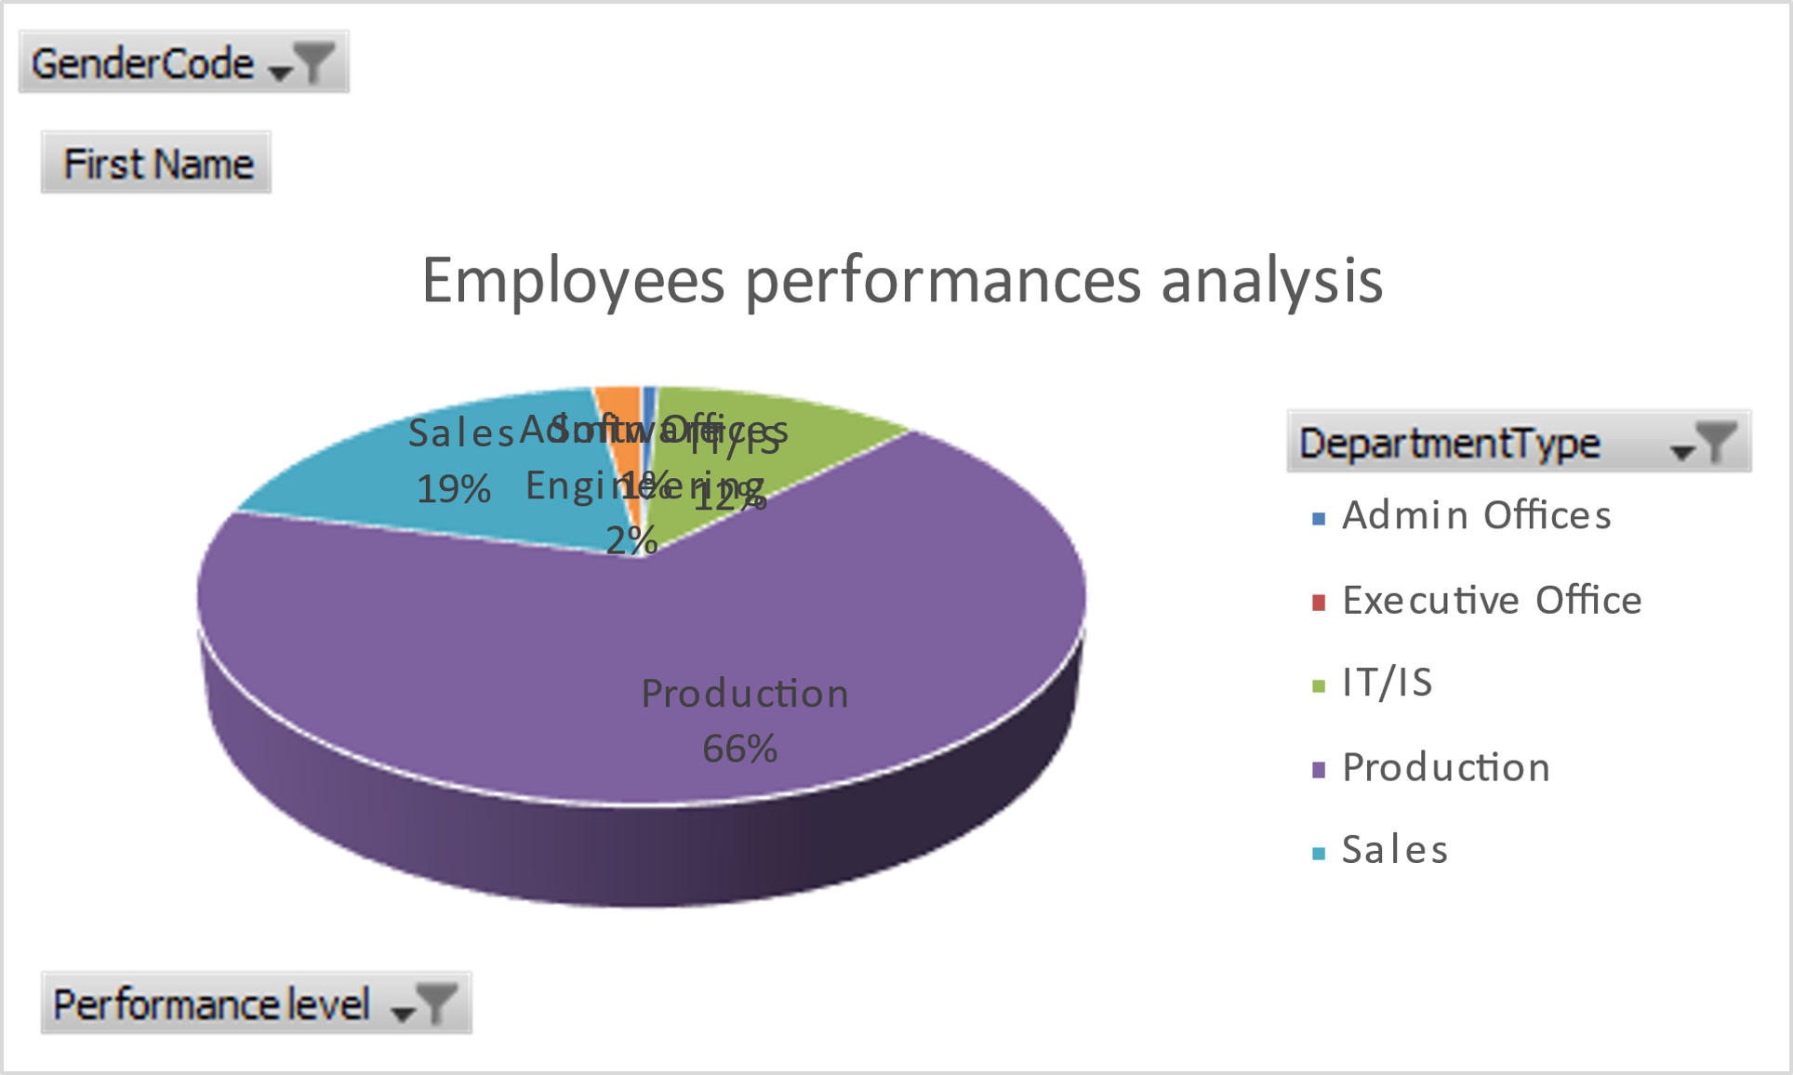
RESULTS

Slide 12
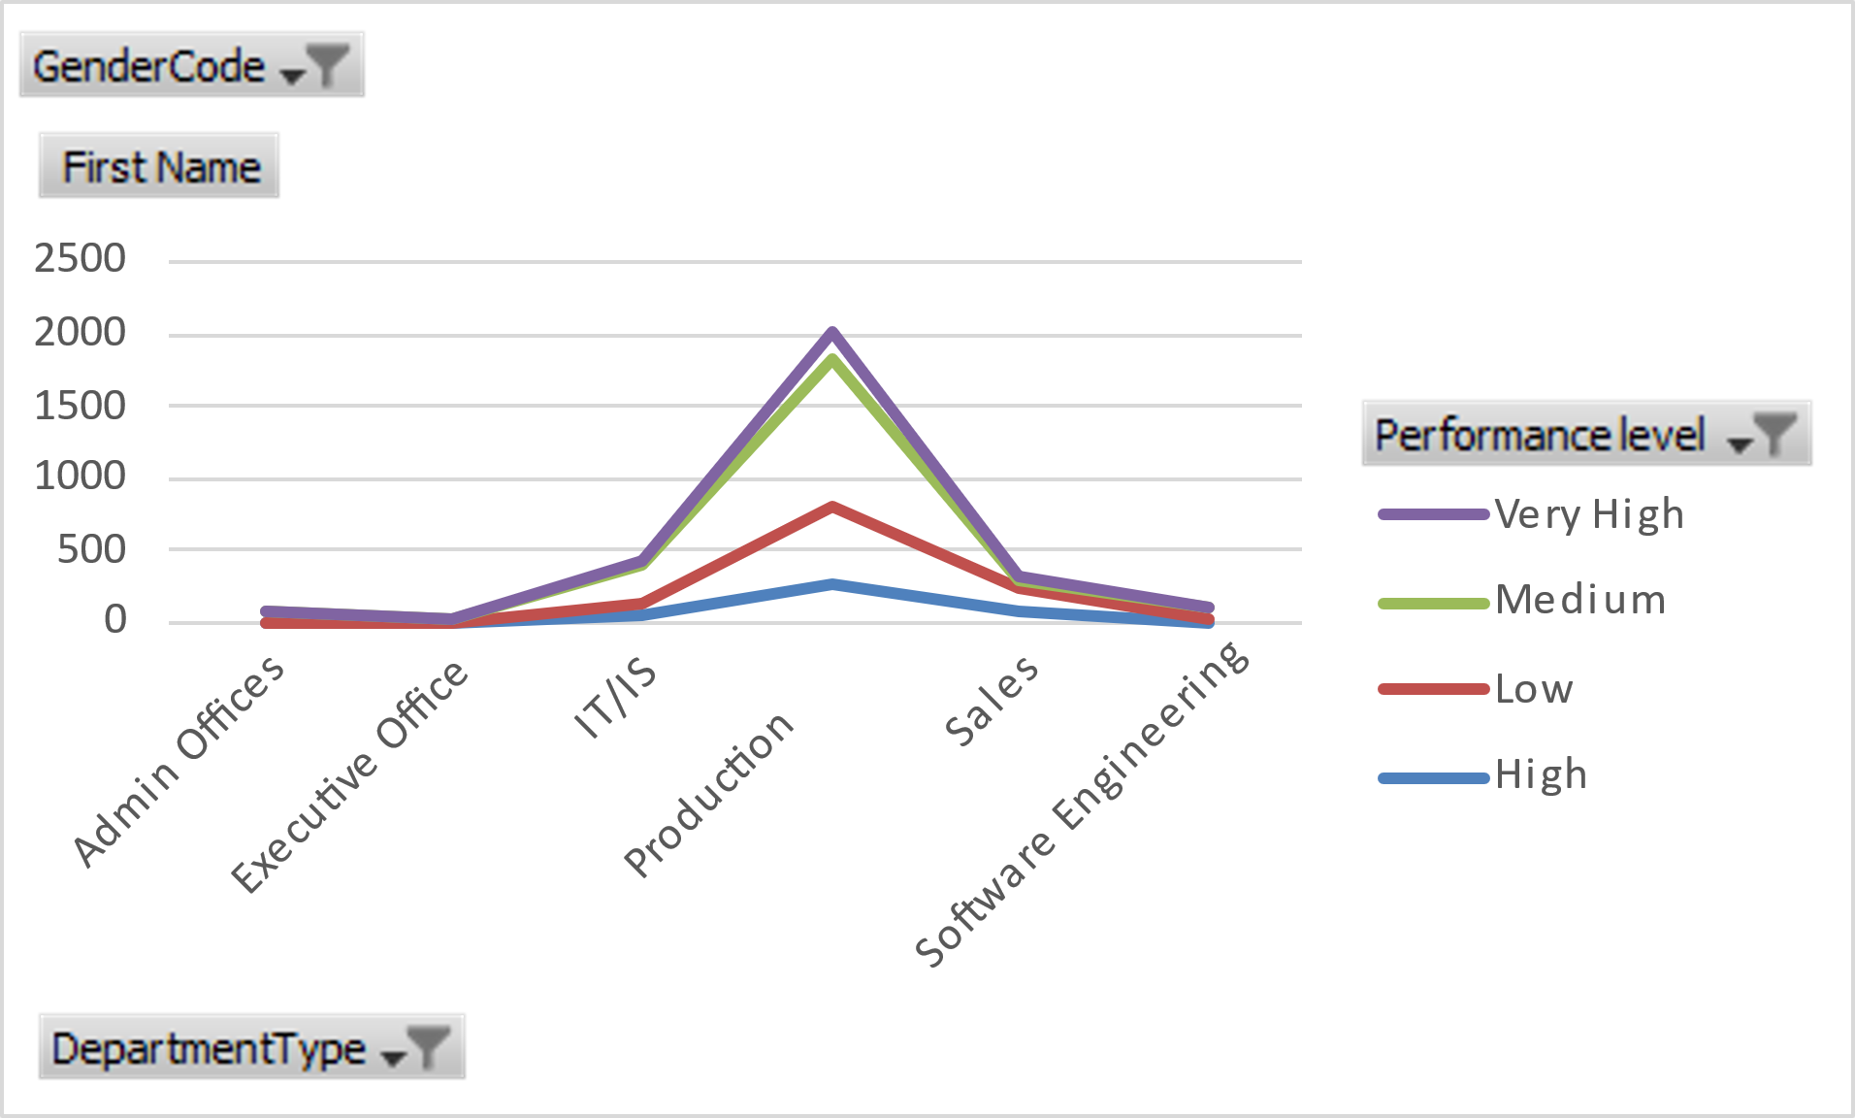


Slide 13
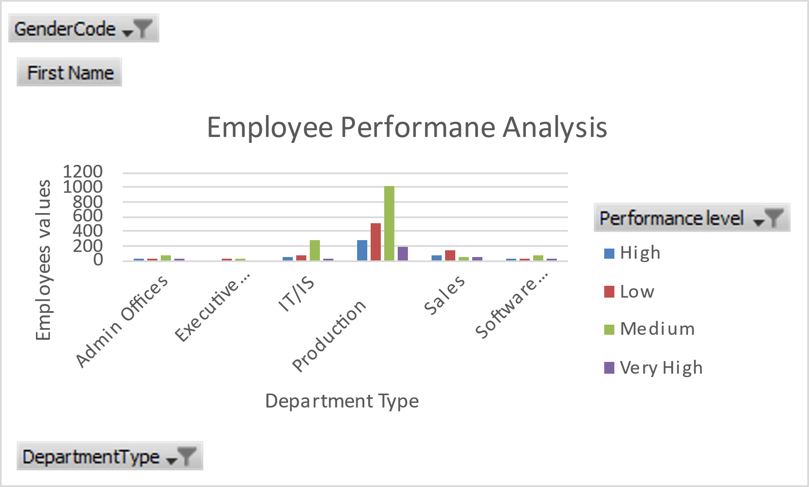

Slide 14
conclusion
This project focuses on employee performance analysis conducted using Excel, it is evident that key performance indicators such as productivity, efficiency play a crucial role in overall performance. The analysis highlights top-performing employees and areas needing improvement. Recommendations include targeted training and better resource allocation. This approach can help enhance employee performance and achieve organizational goals more effectively.

